Slide 1


Micro Frontends
Extending the Micro Services Architecture to Web Development
Jan 2018 | Frontend Developer Love @ Usabilla

Slide 2
Monolith

Slide 3
Monolith

Slide 4
+ Single codebase
+ Easy quick setup
+ No version management
+ Single CI/CD pipeline
Monolith

Slide 5
+ Single codebase
+ Easy quick setup
+ No version management
+ Single CI/CD pipeline
Refactoring is diﬃcult
Try new stack
Experiment
Long build times
Long development times
Long deployment cycles
Monolith

Slide 6
Frontend Monolith
Service 1
Service 2
Service 3

Slide 7
Frontend Monolith???
Service 1
Service 2
Service 3

Slide 8
Frontend Monolith???
Micro Frontends???
Service 1
Service 2
Service 3

Slide 9





Spyros Ioakeimidis
Software Engineer
github @spirosikmd
twitter @spyros_io

Slide 10
Chapter 1: What? Why?

Slide 11



Technology Radar
https://www.thoughtworks.com/radar/techniques/micro-frontends

Slide 12



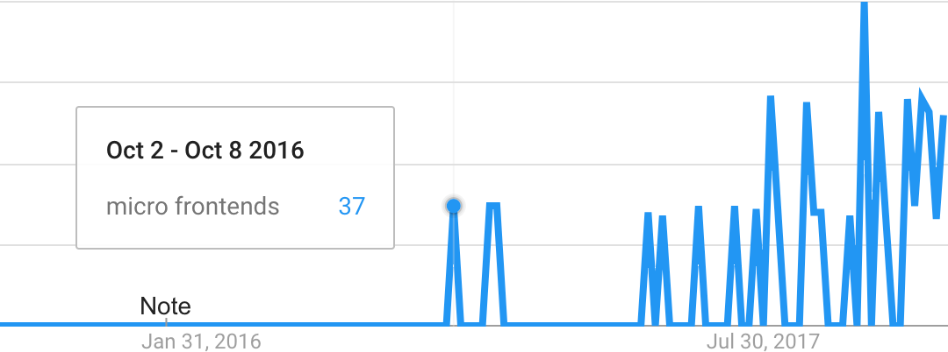

Slide 13

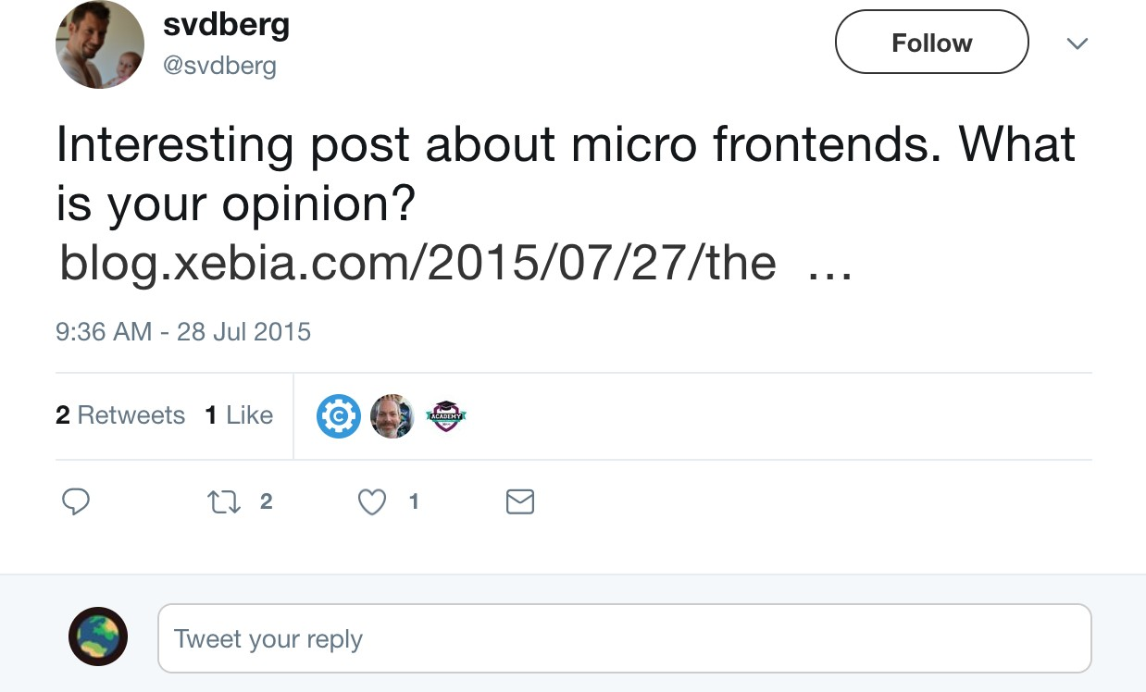
https://twitter.com/svdberg/status/625932935204610048

Slide 14

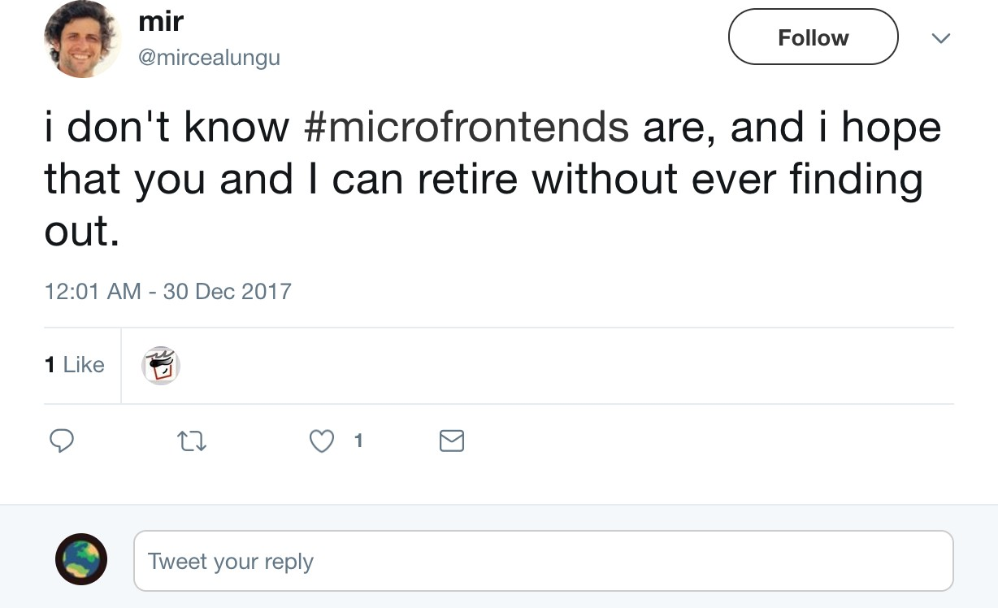
https://twitter.com/mircealungu/status/946878978463289344

Slide 15
Frontend Monolith
Service 1
Service 2
Service 3

Slide 16
Frontend 3
Frontend 1
Frontend 2
Service 1
Service 2
Service 3

Slide 17
Reusable Code
Agility
Reduce risk
Easier Testing
Frontend 1
Frontend 2
Frontend 3
Service 1
Service 2
Service 3

Slide 18
+ Verticalised teams
+ Self contained
+ Vertical decomposition
+ UI Composition
Frontend 1
Frontend 2
Frontend 3
Service 1
Service 2
Service 3

Slide 19
+ Verticalised teams
Proprietary solution
Fit current architecture
Load times
Redundancy risk
+ Self contained
+ Vertical decomposition
+ UI Composition
Frontend 1
Frontend 2
Frontend 3
Service 1
Service 2
Service 3

Slide 20
Reporting
Security
Single Responsibility
Account Management
Interactions

Slide 21
Reporting
Security
Consistent Look & UX
Account Management
Interactions

Slide 22
Reporting
Security
Common Interface
Account Management
Interactions

Slide 23

Separate Deployment
Feels Like One Page
Diﬀerent Frameworks
Tree Shaking
Isolation
Vendor Bundles
Several Frontends
No Version Conflicts
Separate Development

Slide 24
Chapter 2: How?

Slide 25
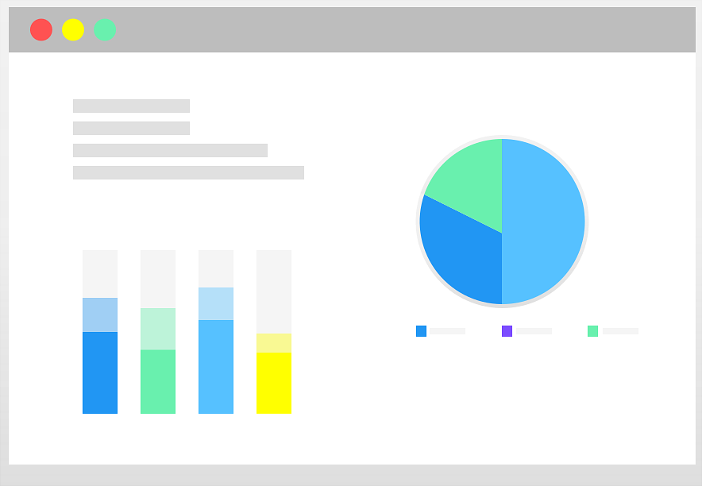
App Shell FTW!

Slide 26


App Shell
State
Routing
iframe

Slide 27
App Shell
- State
iframe
- Routing
Isolation
Separate Deployment Feels like one page Diﬀerent Frameworks Tree Shaking
Several Frontends No Version Conflicts
Separate Development
Vendor Bundles

Slide 28

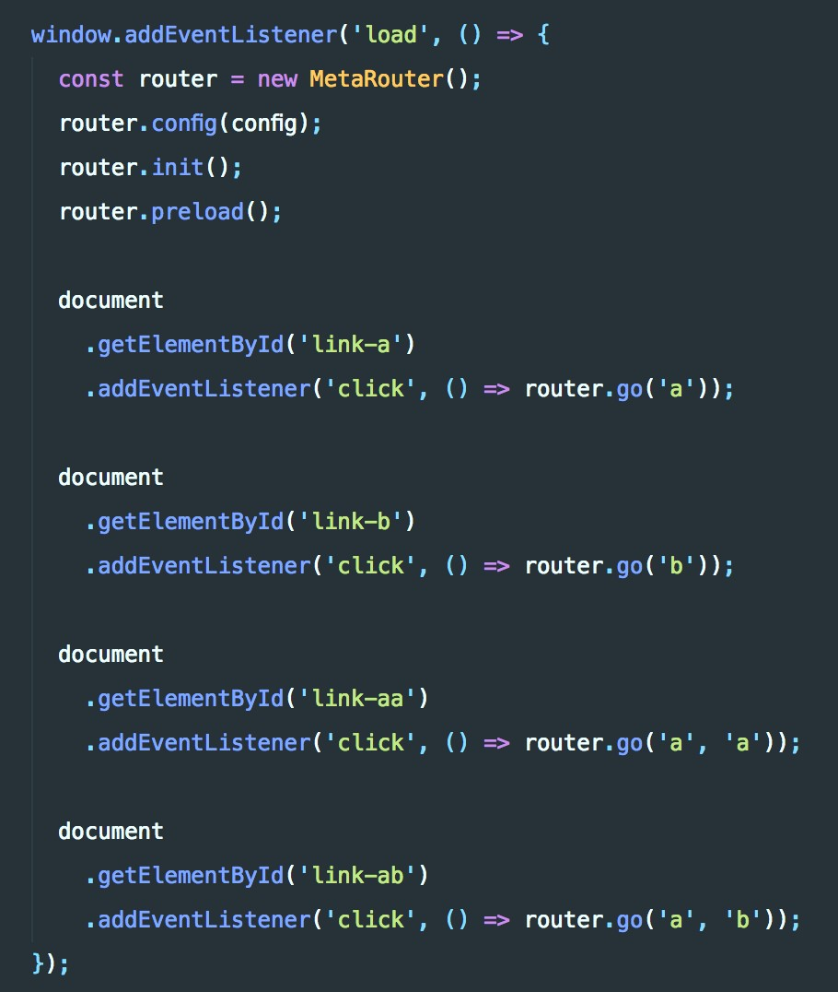

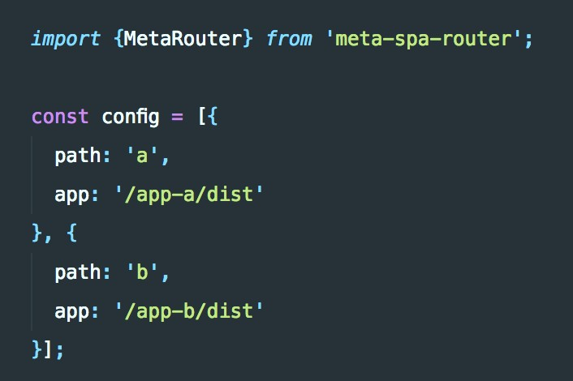
https://github.com/manfredsteyer/meta-router

Slide 29

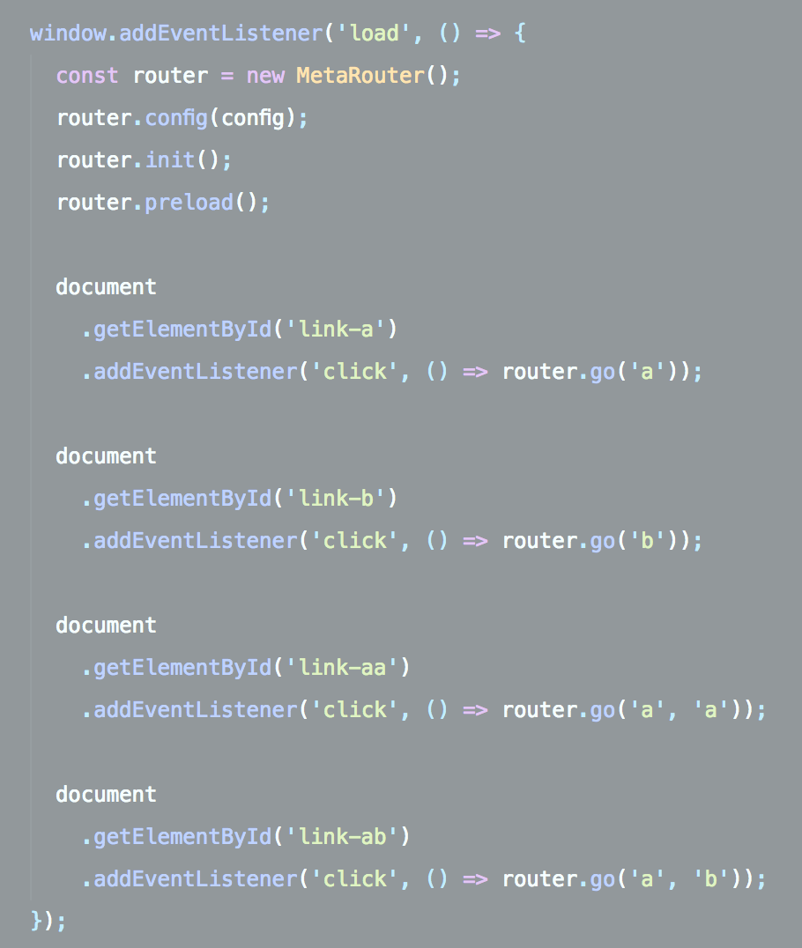



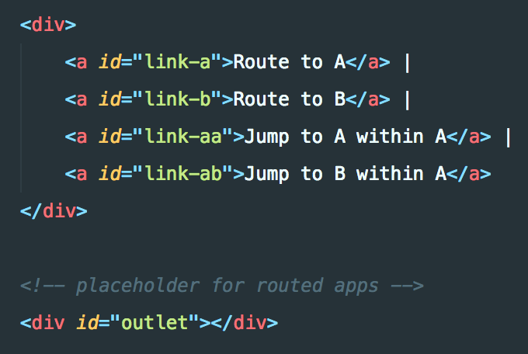
https://github.com/manfredsteyer/meta-router

Slide 30

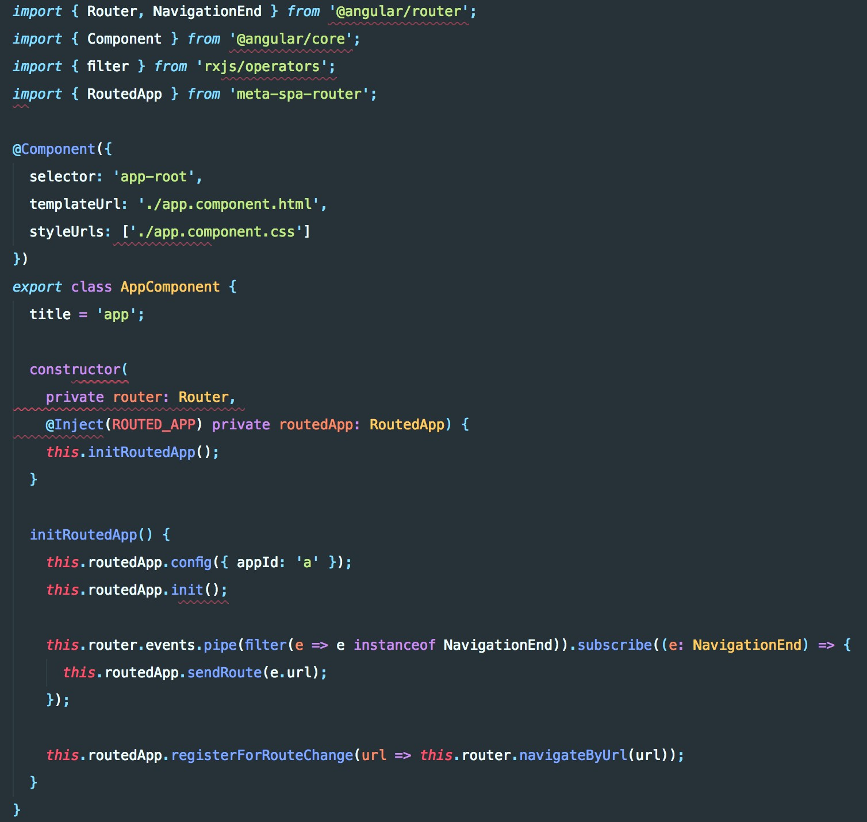
We need to register routing in the micro frontend!

Slide 31




Web Components
Each app a component
Again App Shell is the orchestrator

Slide 32
Web Components
Each app a component
Again App Shell is the orchestrator
Separate Deployment Feels like one page Diﬀerent Frameworks Tree Shaking
Several Frontends Separate Development
Isolation Vendor Bundles
No Version Conflicts

Slide 33

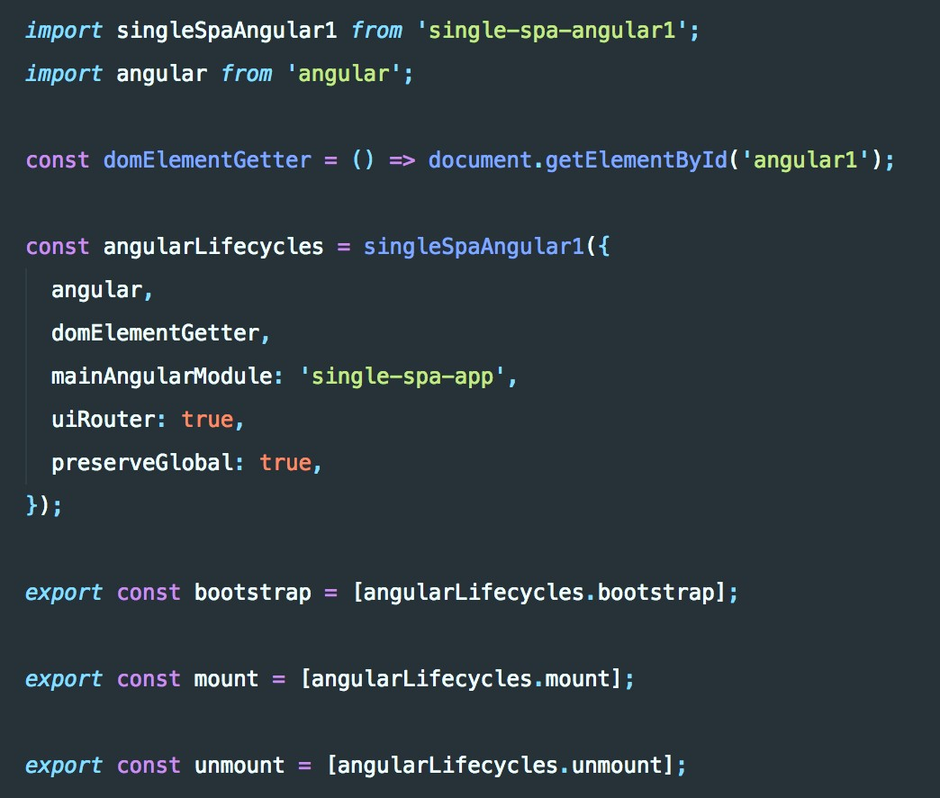

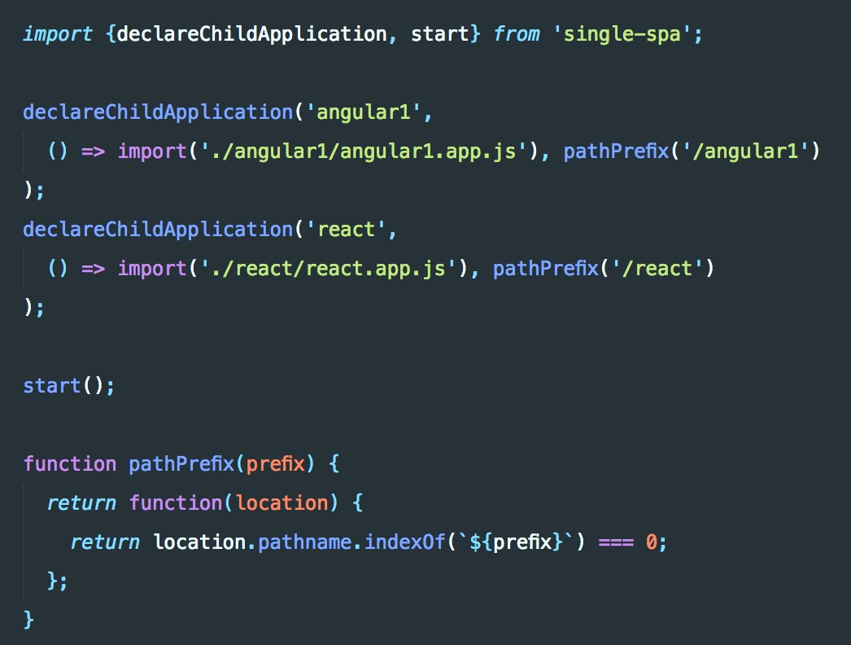
imports
https://github.com/CanopyTax/single-spa https://github.com/medikoo/event-emitter

Slide 34

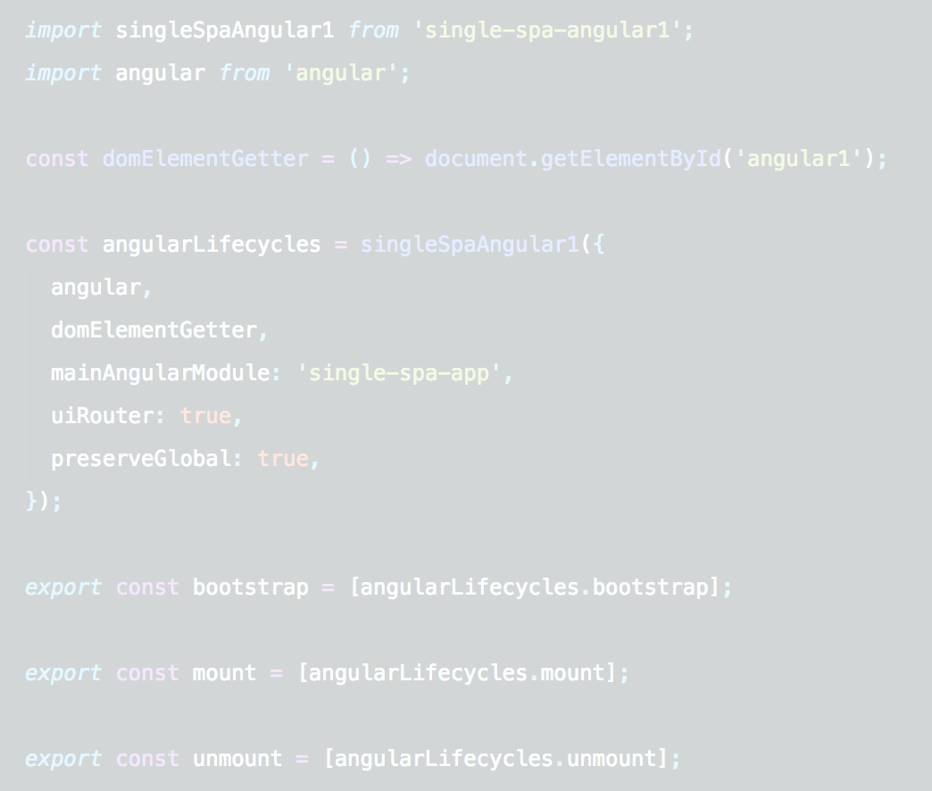

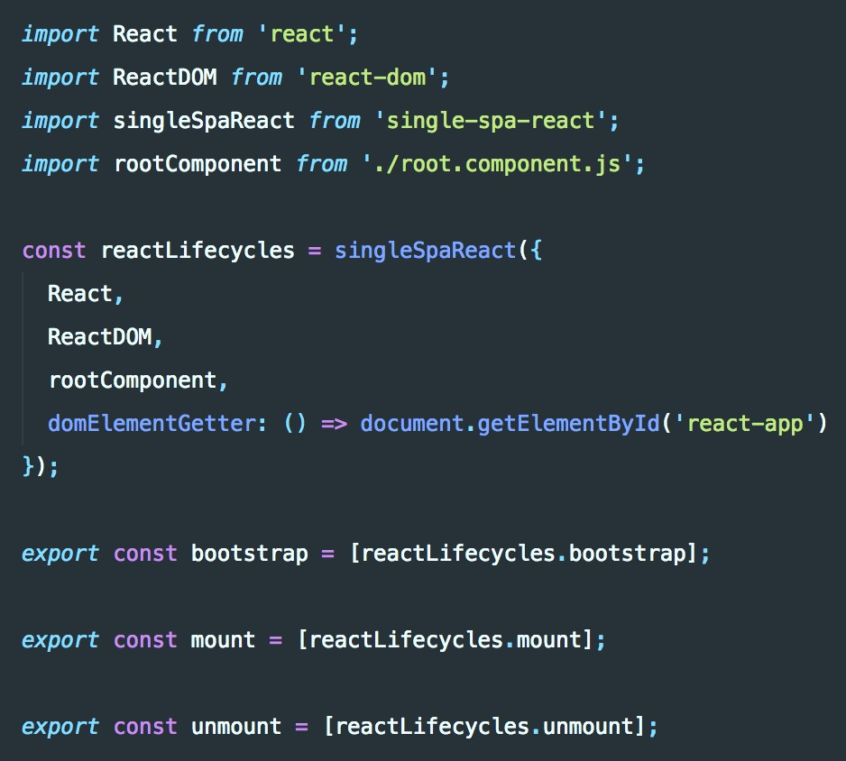
imports
imports
https://github.com/CanopyTax/single-spa https://github.com/medikoo/event-emitter

Slide 35

/reporting
Hybrid
/account
/editor
Account Management
Reporting
Security
Interactions

Slide 36
/reporting
Hybrid
/account
/editor
Account Management
Reporting
Security
Interactions
Isolation
Separate Deployment Feels like one page Diﬀerent Frameworks
Tree Shaking (per app) Several Frontends Separate Development No Version Conflicts
Vendor Bundles

Slide 37

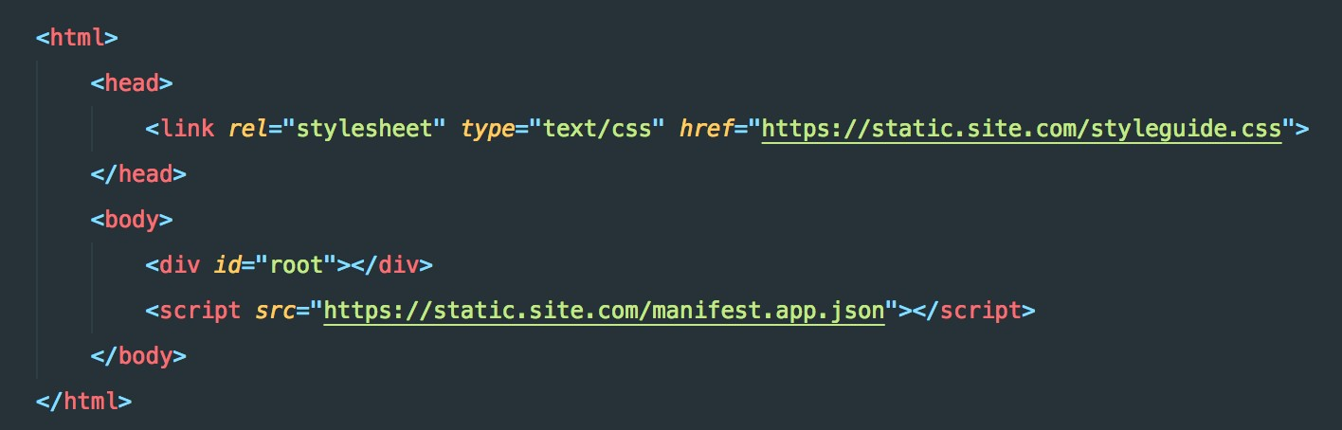

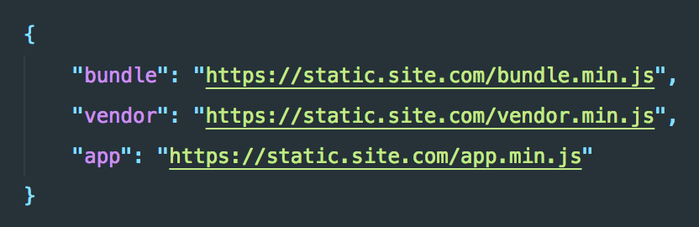
Move responsibility to micro frontends
loads

Slide 38
Chapter 3: Challenges?

Slide 39

Integration!

Slide 40
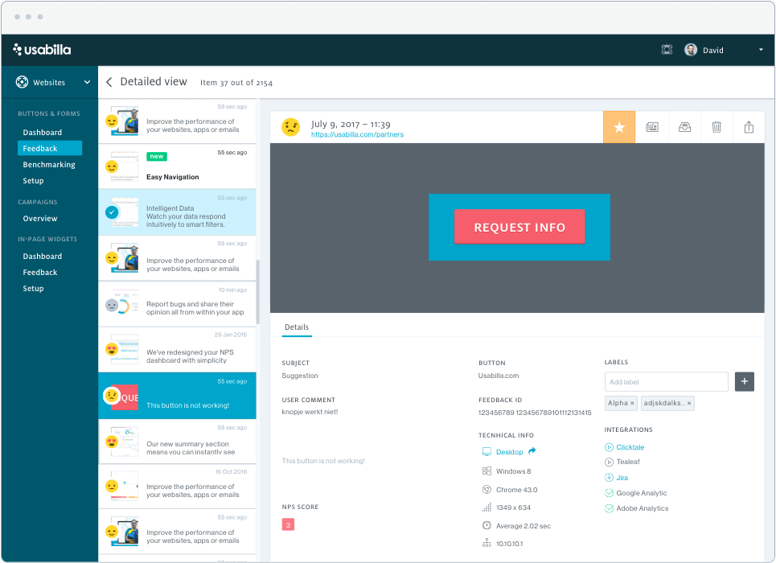

Is this a micro frontend?

Slide 41

Or are these micro frontends?

Slide 42

app-2.js
…
app-1.js
…
app.css
app-2.css
app-1.css
This person suﬀers

Slide 43

Its your time to figure out what the previous developers had in mind!
We use docker, it should work!
And this person suﬀers

Slide 44

Adaptive, Responsive & Accessible Design

Slide 45


Integration Testing is probably your best bet!

Slide 46
Chapter 4: Thoughts?

Slide 47
You might not need micro frontends yet
Yes
Can you fit your team around a large table?
Micro frontends might help you
No
http://www.dwmkerr.com/the-death-of-microservice-madness-in-2018/

Slide 48
You might not need micro frontends yet
Yes
Can you fit your team around a large table?
Micro frontends might help you
No
Integration might be complicated
Yes
Do you have monolithic dependencies?
Micro frontends may be easily integrated
No
http://www.dwmkerr.com/the-death-of-microservice-madness-in-2018/

Slide 49
You might not need micro frontends yet
Yes
Can you fit your team around a large table?
Micro frontends might help you
No
Yes
Integration might be complicated
Do you have monolithic dependencies?
Micro frontends may be easily integrated
No
Yes
Micro frontends might be valuable
Got container, orchestration, devops experience?
Consider giving them a try first
No
http://www.dwmkerr.com/the-death-of-microservice-madness-in-2018/

Slide 50

Extend the monolith?

Slide 51
“Architecture in micro frontends is domain driven, and low level components can be technical driven.
It makes sense to follow a top down approach.
Thinking of how to split your monolith in apps according to your domain. No big design upfront as things might go wrong.”
Stefan Tilkov @ Devoxx Belgium 2016

Slide 52












Slide 53


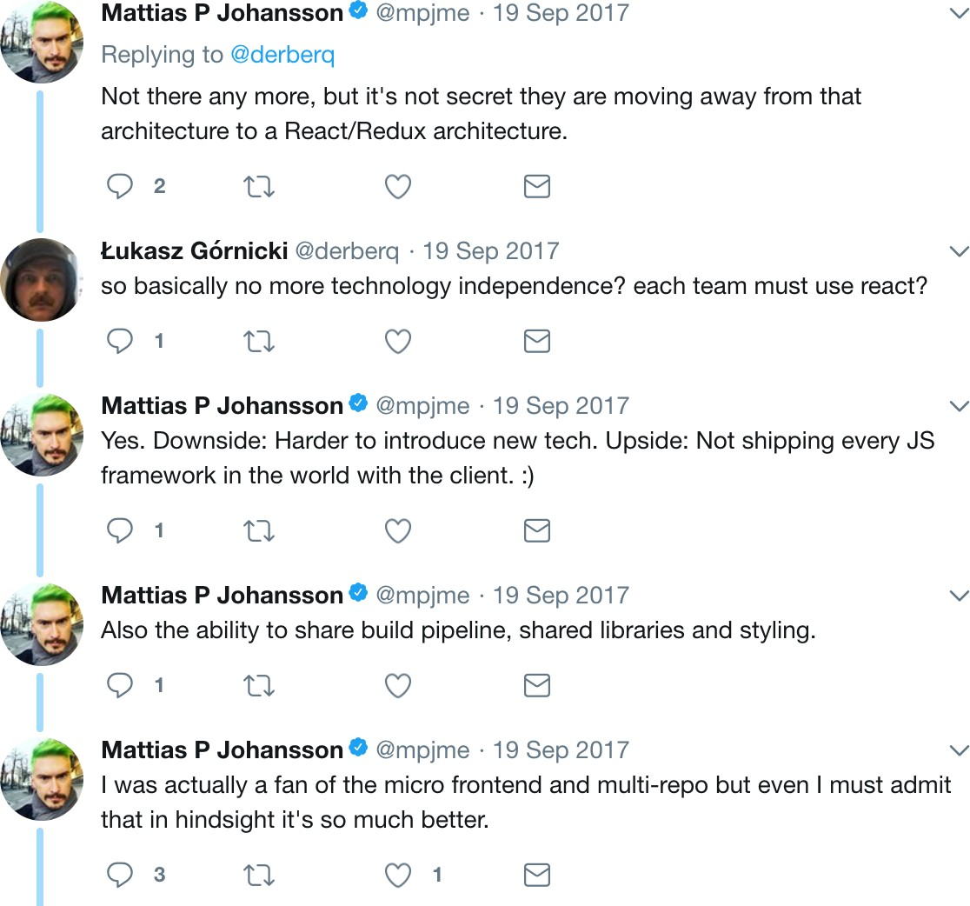
https://twitter.com/derberq/status/910056617881817089

Slide 54

Thank you!
https://jobs.usabilla.com/

Slide 55

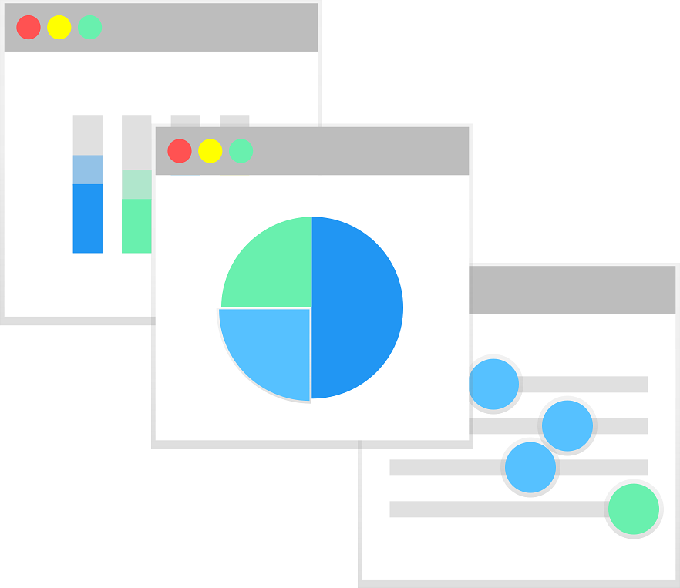
https://undraw.co/

Slide 56
Check these out!
https://medium.com/@gilfink/why-im-betting-on-web-components-and-you-should-think- about-using-them-too-8629396e27a
https://softwarearchitekt.at/post/2017/12/28/a-software-architect-s-approach-towards-using- angular-and-spas-in-general-for-microservices-aka-microfrontends.aspx
https://www.upwork.com/blog/2017/05/modernizing-upwork-micro-frontends/
https://x-team.com/blog/micro-frontend
https://medium.com/@tomsoderlund/micro-frontends-a-microservice-approach-to-front-end-web- development-f325ebdadc16
https://www.packtpub.com/books/content/what-micro-frontend
https://technologyconversations.com/2015/08/09/including-front-end-web-components-into- microservices
https://www.tikalk.com/js/introduction-to-micro-frontends/
https://micro-frontends.zeef.com/elisabeth.engel? ref=elisabeth.engel&share=ee53d51a914b4951ae5c94ece97642fc

